Slide 1
Convolutional Neural Networks
(Many slides from Stanford CS230, Stanford CS231n, and MIT 6.S191)

Slide 2
Outline
Basic Idea of Convolutional Neural Networks
CNN: Three Types of Layers
Convolution Layer (跟數學上的不太一樣，但概念是一樣的)
Pooling Layer
Fully connected layer
Summary

Slide 3
Convolutional Neural Networks
A convolutional neural network (CNN) is a specialized type of deep learning models with one or more convolutional layers (and some other layers).
It is most commonly applied to computer vision tasks to understand digital images, such as processing, analyzing, and feature extraction.(最常應用在處理電腦影像的問題)
應用：可以訓練電腦去看醫學的片子，節省醫生的時間

Slide 4

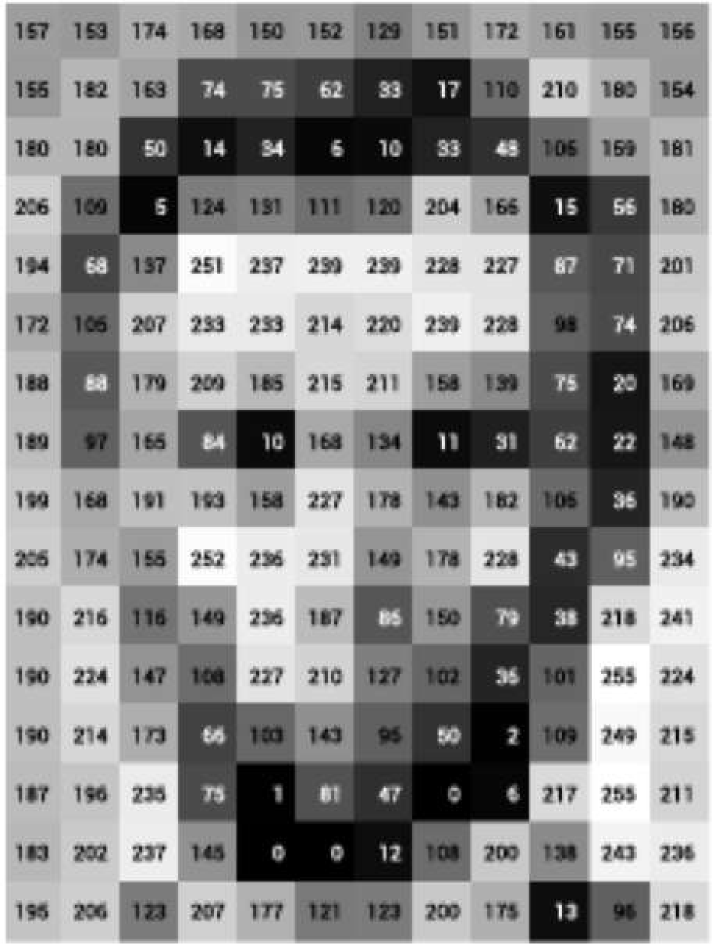
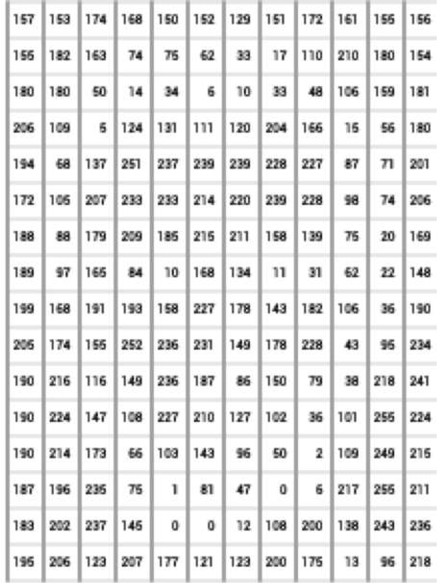
Images are Numbers
最有名的：辨識images
應用：處理手寫辨識(支票、簽名)
What the computer sees
An image is just a matrix of numbers [0,255]! i.e., 1080x1080x3 for an RGB image

Slide 5

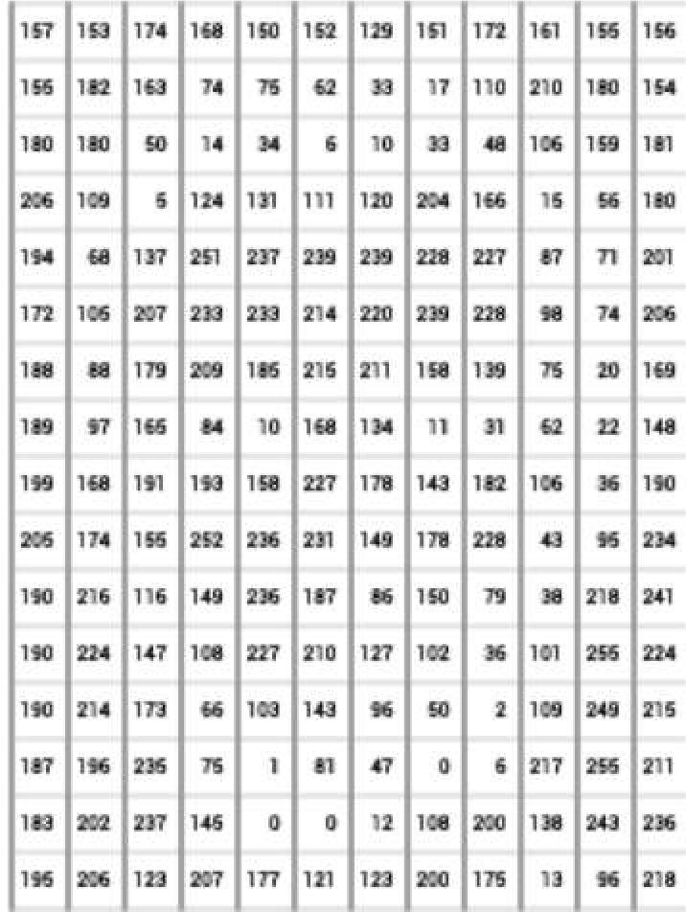
Tasks in Computer Vision
此例有使用soft max，
下方矩陣的sum是1
Lincoln
0.8
Washington
0.1
classification
Jefferson
0.05
Obama
0.05
Input Image Pixel Representation
Classification: output variable takes class label. Can produce probability of belonging to a particular class

Slide 6
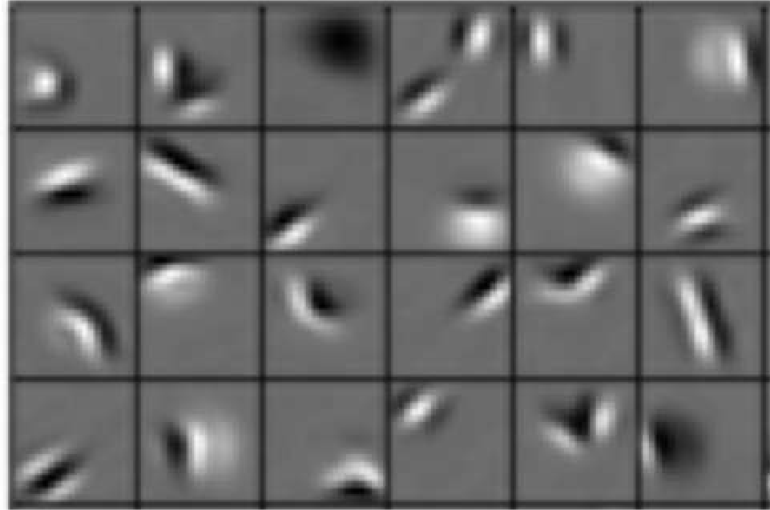
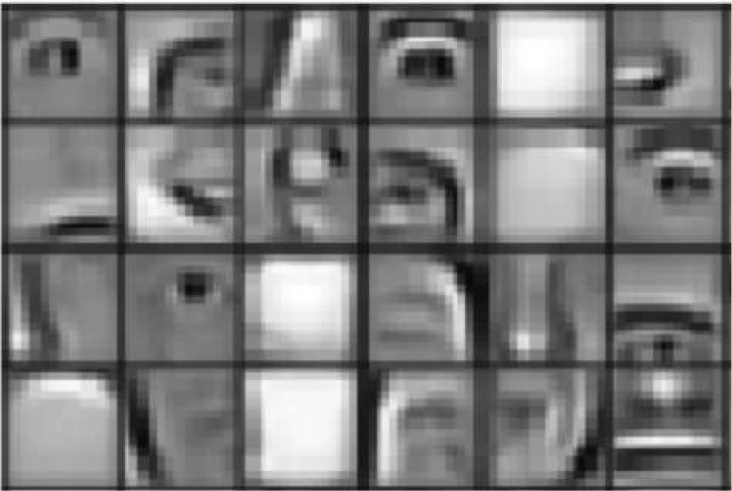
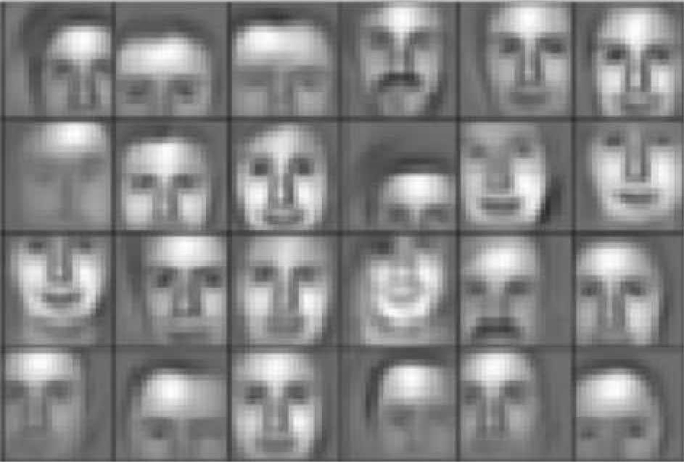
Learning Feature Representations
Can we learn a hierarchy of features directly from the data instead of hand engineering(資料的前置處理)?
Low level features Mid level features High level features
Edges, dark spots
Eyes, ears, nose
Facial structure
先告訴電腦眼睛在哪裡?嘴巴在哪裡?
偵測好後再告訴電腦眼睛是怎樣大小是怎樣?(早期還沒有convolution neural network時的做法)

Slide 7
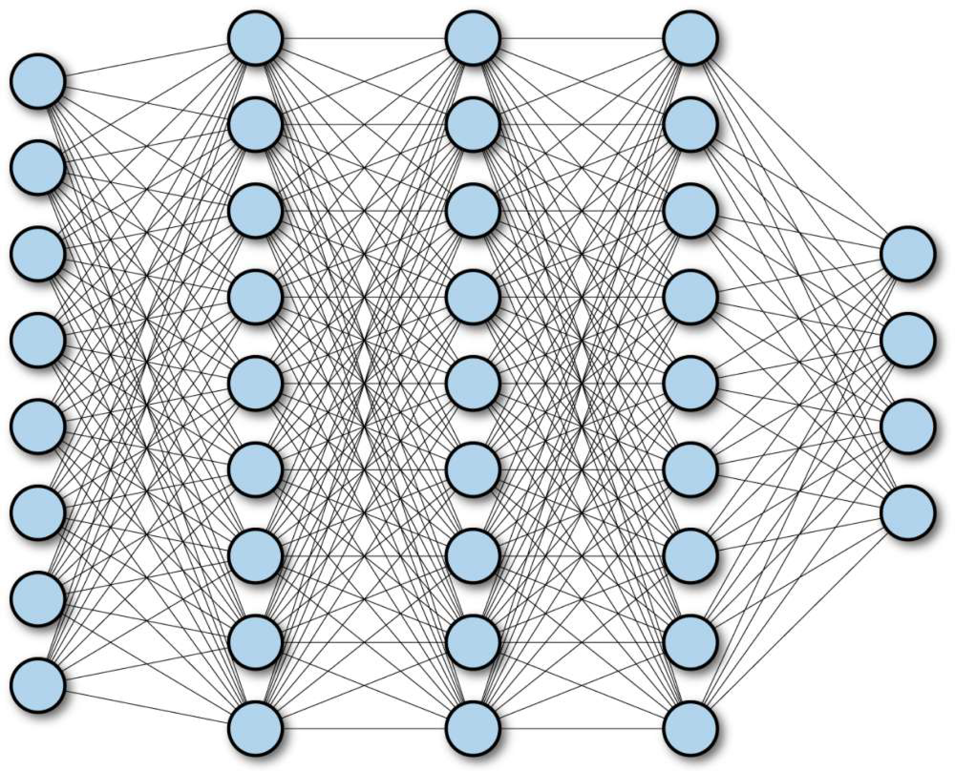
Fully Connected Neural Network

Slide 8
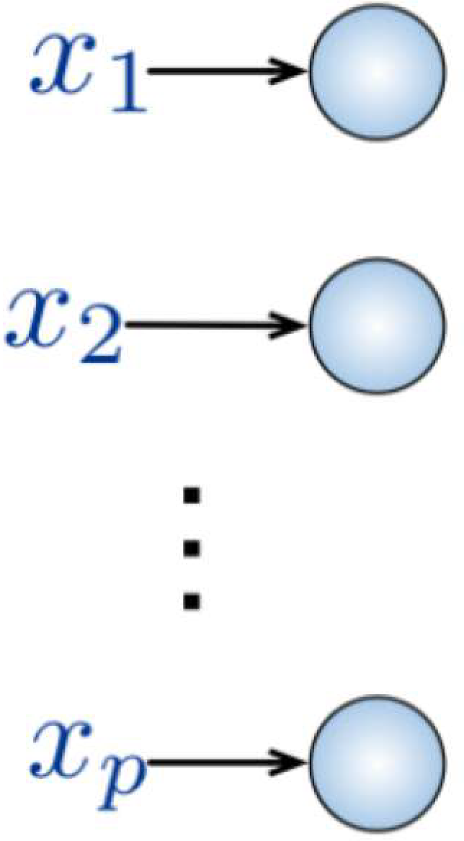

Fully Connected Neural Network
Input:
2D image
Vector of pixel values
Fully Connected:
Connect neuron in hidden layer to all neurons in input layer
No spatial information!
And many, many parameters!
How can we use spatial structure in the input to inform the architecture of the network?

Slide 9
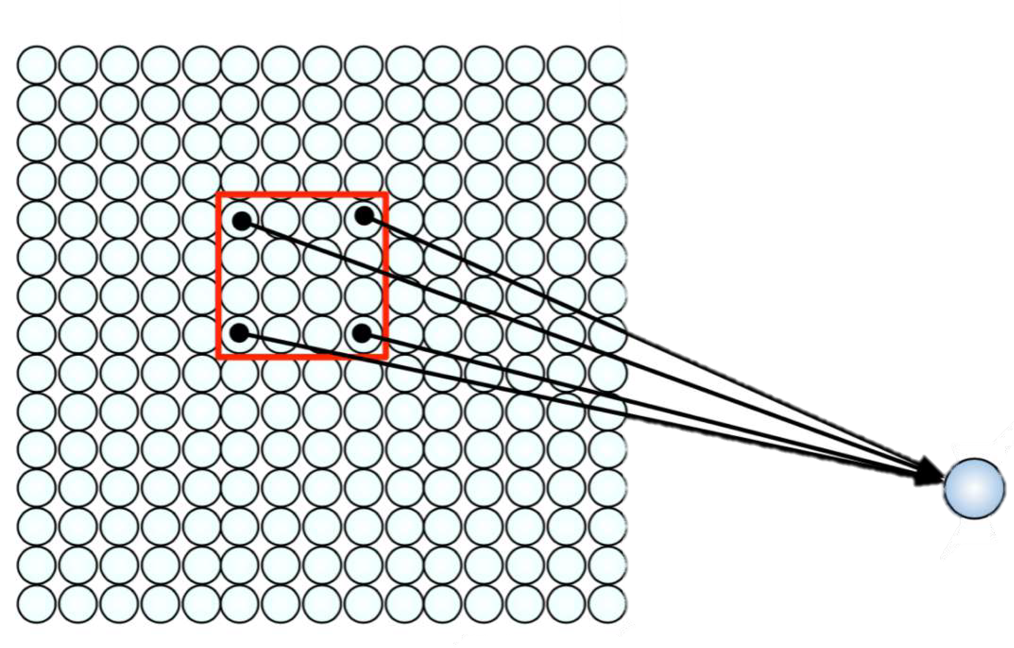
Using Spatial Structure
Input: 2D image.
Array of pixel values
Idea: connect patches of input to neurons in hidden layer.
Neuron connected to region of input. Only “sees” these values.

Slide 10
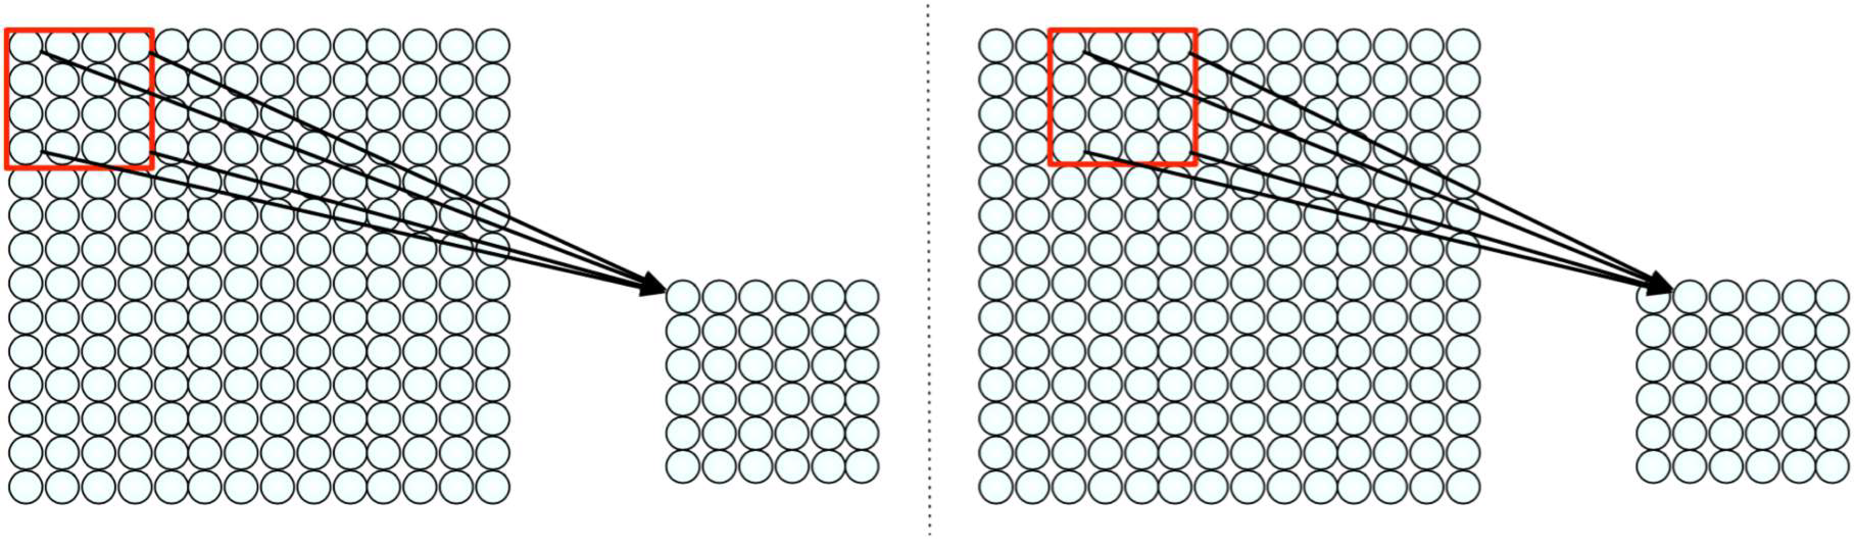
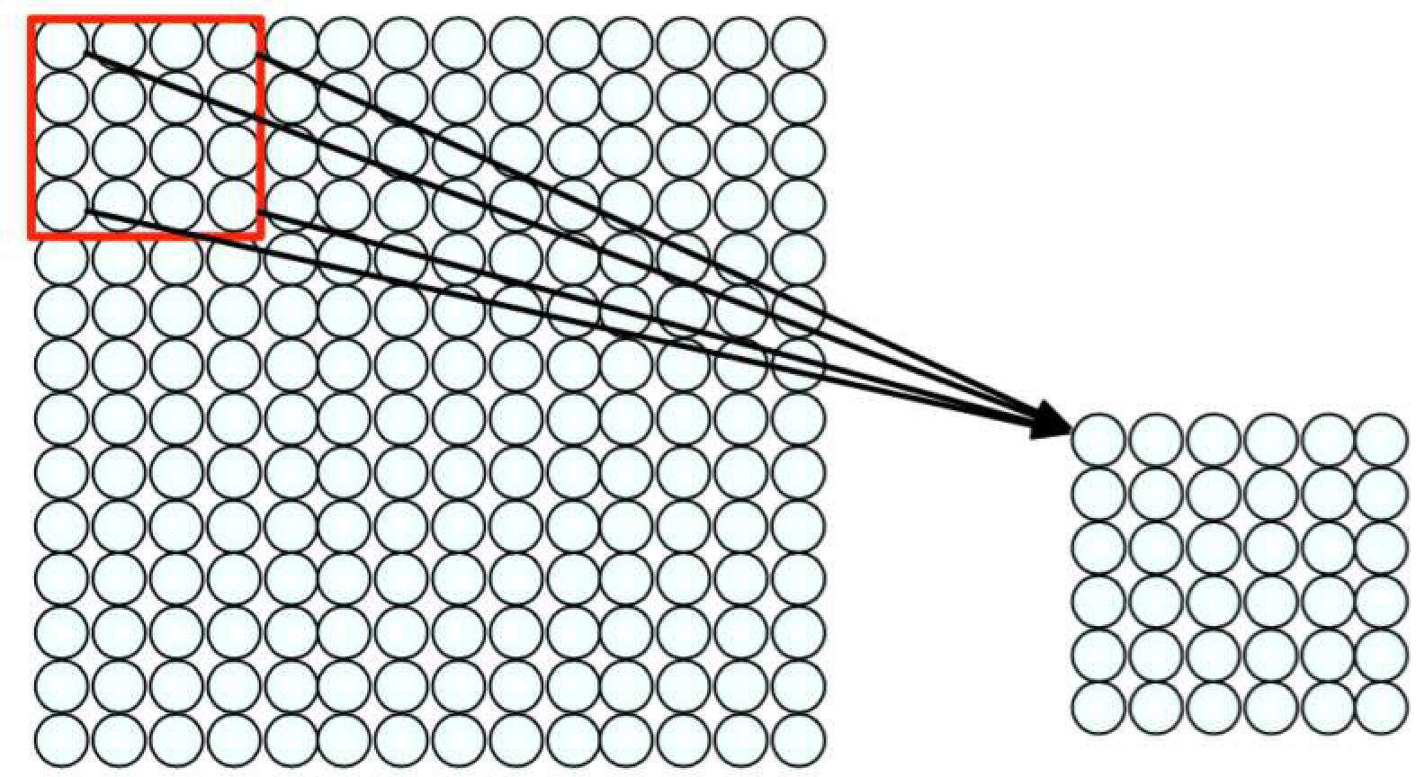
Using Spatial Structure
用16個weight來掃描整個二維影像，所以它的parameter銳減
一次向右一兩步
Connect patch in input layer to a single neuron in subsequent layer.
Use a sliding window to define connections.
How can we weight the patch to detect particular features?

Slide 11
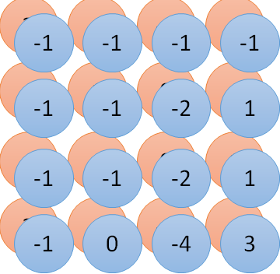
Convolution vs. Fully Connected
1 | 0 | 0 | 0 | 0 | 1
0 | 1 | 0 | 0 | 1 | 0
0 | 0 | 1 | 1 | 0 | 0
1 | 0 | 0 | 0 | 1 | 0
0 | 1 | 0 | 0 | 1 | 0
0 | 0 | 1 | 0 | 1 | 0
1 | -1 | -1
-1 | 1 | -1
-1 | -1 | 1
-1 | 1 | -1
-1 | 1 | -1
-1 | 1 | -1
Convolution
Ｉmage
1 | 0 | 0 | 0 | 0 | 1
0 | 1 | 0 | 0 | 1 | 0
0 | 0 | 1 | 1 | 0 | 0
1 | 0 | 0 | 0 | 1 | 0
0 | 1 | 0 | 0 | 1 | 0
0 | 0 | 1 | 0 | 1 | 0
Fully-connected
……
……

Slide 12
CNN: Three Types of Layers
In a convolutional neural network (CNN), there are basically three types of layers:
Convolution layer卷積層
卷積運算就是將原始圖片的與特定的Feature Detector(filter)做卷積運算(符號⊗)
Pooling layer池化層
在Pooling Layer這邊主要是採用Max Pooling，Max Pooling的概念很簡單只要挑出矩陣當中的最大值就好，Max Pooling主要的好處是當圖片整個平移幾個Pixel的話對判斷上完全不會造成影響，以及有很好的抗雜訊功能。
Fully connected layer全連接層
將之前的結果平坦化之後接到最基本的神經網絡

Slide 13
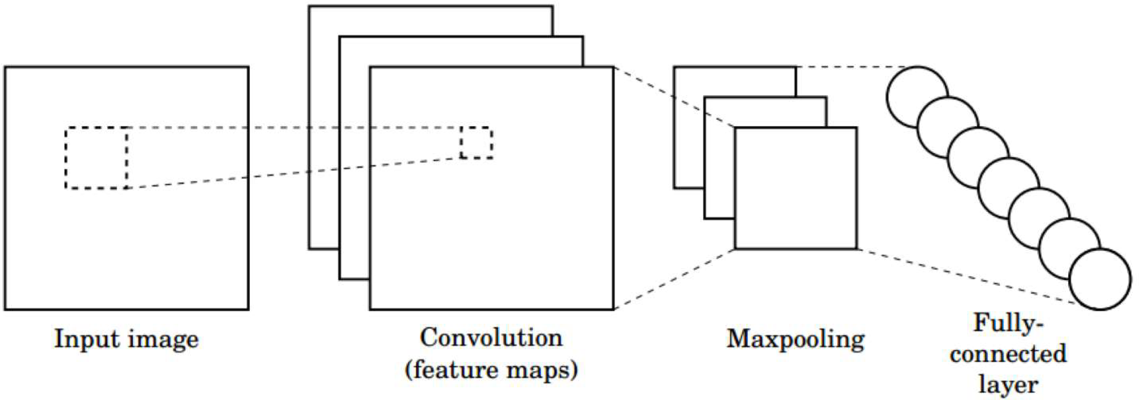
CNN: Three Types of Layers
1/29/19

Slide 14
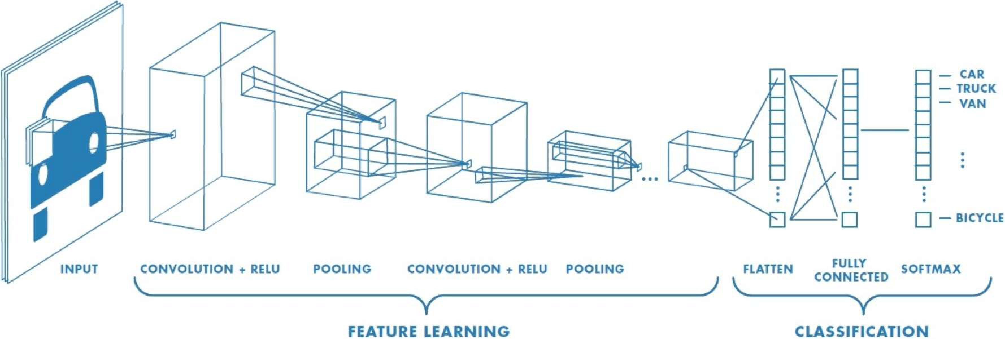
CNN: Three Types of Layers
躺平
6.S191 Introduction to Deep Learning
introtodeeplearning.com

Slide 15
Convolution Layer
Filter (Kernel)
Padding
Stride
Convolutions Over Volumes
One Layer of a Convolutional Network
Why Convolutions?

Slide 16
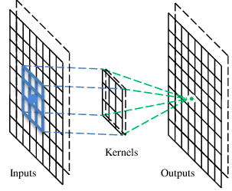
A convolutional layer
A convolutional layer has a number of filters that does convolutional operation.
A filter

Slide 17
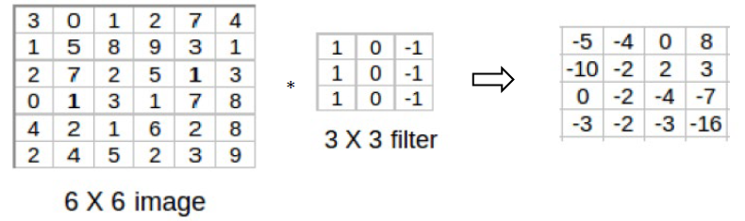
Filter (Kernel)
Example: Convolve a 6 × 6 image with a 3 × 3 filter:
純量越大，兩者越像，跟cosθ有關

Slide 18
Filter
These are the network parameters to be learned.
1 | -1 | -1
-1 | 1 | -1
-1 | -1 | 1
1 | 0 | 0 | 0 | 0 | 1
0 | 1 | 0 | 0 | 1 | 0
0 | 0 | 1 | 1 | 0 | 0
1 | 0 | 0 | 0 | 1 | 0
0 | 1 | 0 | 0 | 1 | 0
0 | 0 | 1 | 0 | 1 | 0
Filter 1
-1 | 1 | -1
-1 | 1 | -1
-1 | 1 | -1
Filter 2
……
6 x 6 image
Each filter detects a small pattern (3 x 3).

Slide 19
Filter
1 | -1 | -1
-1 | 1 | -1
-1 | -1 | 1
Filter 1
Stride = 1
1 | 0 | 0 | 0 | 0 | 1
0 | 1 | 0 | 0 | 1 | 0
0 | 0 | 1 | 1 | 0 | 0
1 | 0 | 0 | 0 | 1 | 0
0 | 1 | 0 | 0 | 1 | 0
0 | 0 | 1 | 0 | 1 | 0
Dot
product
3
-1
6 x 6 image

Slide 20
Filter
1 | -1 | -1
-1 | 1 | -1
-1 | -1 | 1
Filter 1
Stride = 1
1 | 0 | 0 | 0 | 0 | 1
0 | 1 | 0 | 0 | 1 | 0
0 | 0 | 1 | 1 | 0 | 0
1 | 0 | 0 | 0 | 1 | 0
0 | 1 | 0 | 0 | 1 | 0
0 | 0 | 1 | 0 | 1 | 0
3
-1
-3
-1
-3
1
0
-3
-3
-3
0
1
3
-2
-2
-1
6 x 6 image

Slide 21
Convolution
-1 | 1 | -1
-1 | 1 | -1
-1 | 1 | -1
Filter 2
Stride = 1
Repeat this for each filter
1 | 0 | 0 | 0 | 0 | 1
0 | 1 | 0 | 0 | 1 | 0
0 | 0 | 1 | 1 | 0 | 0
1 | 0 | 0 | 0 | 1 | 0
0 | 1 | 0 | 0 | 1 | 0
0 | 0 | 1 | 0 | 1 | 0
3
-1
-3
-1
-1
-1
-1
-1
-3
1
0
-3
-1
-1
-2
1
Feature
Map
-3
-3
0
1
-1
-1
-2
1
3
-2
-2
-1
6 x 6 image
-1
0
-4
3
Two 4 x 4 images
Forming two 4 x 4 matrix

Slide 22
Convolution
Convolving an input of 6 × 6 dimensions with a 3 × 3 filter results in 4 × 4 output.
We can generalize it:
Input size: n × n
Filter size: f × f
⇒ Output size: (n − f + 1) × (n − f + 1)

Slide 23
Padding 補丁
奇數比較適合
偶數不適合
Two disadvantages after we apply a convolutional operation (卷積的缺點) :
Throwing away information from the edges
Shrinking the size of the image
⇒ (解決辦法)Pad the image with an additional border of zeros to overcome these issues.

Slide 24
Padding (需要幾層padding?)
If we add ‘p’ padding layers such that the output size is the same as the input size, then:
n + 2p – f + 1 = n ⇒ p = ( f – 1 ) / 2
For example:
If we use a 3 × 3 filter then one layer of zeros must be added to the borders. ( p = ( 3 – 1 )/2)
Similarly, if a 5 × 5 filter is used then two layers of zeros must be appended to the border of the image.

Slide 25
Padding
There are two common choices for padding:
Same convolution: padding so that the output size is the same as the input size
(補丁讓輸出的size和輸入的size一樣)
Valid convolution: no padding(沒有補丁)

Slide 26
Stride 滑步
1 | -1 | -1
-1 | 1 | -1
-1 | -1 | 1
Filter 1
If stride = 2
會除不盡
1 | 0 | 0 | 0 | 0 | 1
0 | 1 | 0 | 0 | 1 | 0
0 | 0 | 1 | 1 | 0 | 0
1 | 0 | 0 | 0 | 1 | 0
0 | 1 | 0 | 0 | 1 | 0
0 | 0 | 1 | 0 | 1 | 0
3
-3
Stride controls how the filter convolves around the input image.
6 x 6 image

Slide 27
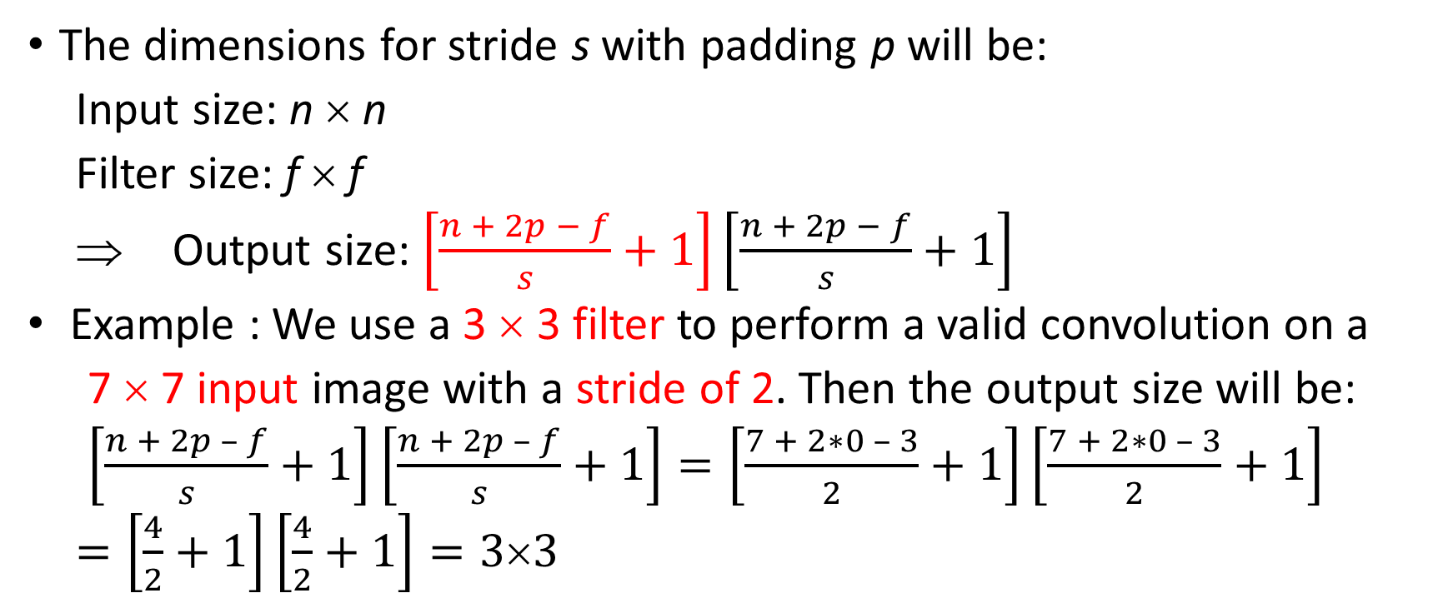
Stride
The dimensions for stride s with padding p will be:
Input size: n × n
Filter size: f × f
⇒ Output size: $\left[\frac{n + 2p − f}{s}+1\right]\left[\frac{n + 2p − f}{s}+1\right]$
Example : We use a 3 × 3 filter to perform a valid convolution on a
7 × 7 input image with a stride of 2. Then the output size will be:
$\left[\frac{n + 2p – f}{s}+1\right]\left[\frac{n + 2p – f}{s}+1\right]=\left[\frac{7 + 2∗0 – 3}{2}+1\right]\left[\frac{7 + 2∗0 – 3}{2}+1\right]$
$=\left[\frac{4}{2}+1\right]\left[\frac{4}{2}+1\right]=3×3$

Slide 28
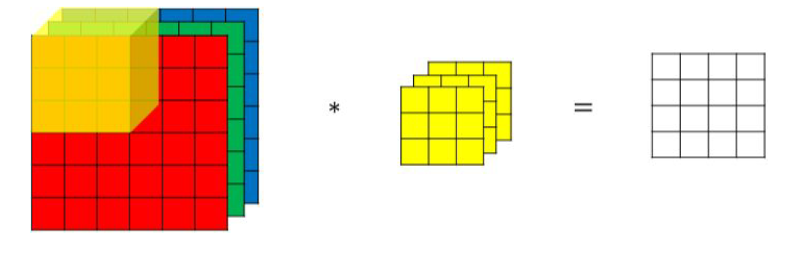
Convolutions Over Volumes
Suppose that we have an RGB image of shape 6 × 6 × 3 instead of a 2-D image. Then we will use a 3 × 3 × 3 filter instead of a 3 × 3 filter.
For example:
The number of channels in the input and a filter should be the same.
(輸入和過濾的channels必須相同)
Each element of the output is the sum of the element-wise product of 27 values from an input window and the filter.

Slide 29
Convolutions Over Volumes
Multiple filters:
If we use two filters, the output dimensions will be 4 × 4 × 2.
有兩個filters
channel通道

Slide 30
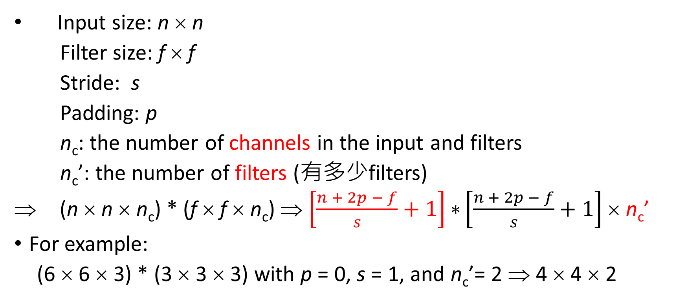
Convolutions Over Volumes
Input size: n × n
Filter size: f × f
Stride: s
Padding: p
n_{c}: the number of channels in the input and filters
n_{c}’: the number of filters (有多少filters)
⇒ (n × n × n_{c}) * (f × f × n_{c}) ⇒ $\left[\frac{n + 2p − f}{s}+1\right]\text{∗}\left[\frac{n + 2p − f}{s}+1\right]$ × n_{c}’
For example:
(6 × 6 × 3) * (3 × 3 × 3) with p = 0, s = 1, and n_{c}’= 2 ⇒ 4 × 4 × 2

Slide 31
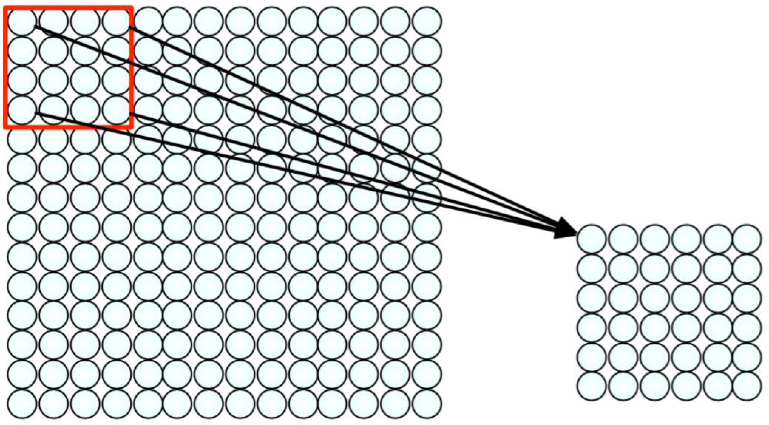
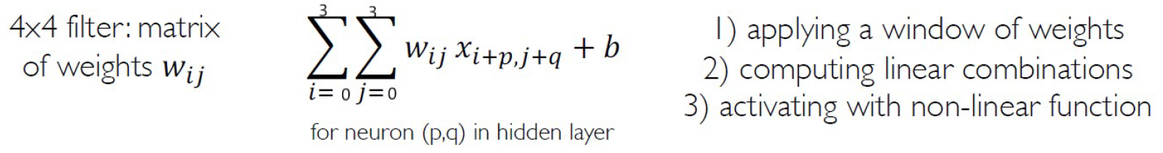
One Layer of a Convolutional Network
For a neuron in hidden layer:
Take inputs from patch
Compute weighted sum + bias
Apply an activation function
6.S191 Introduction to Deep Learning
introtodeeplearning.com

Slide 32
One Layer of a Convolutional Network
Once we get an output after taking a dot product between the filter and a small chunk of the image, we add a bias term to the output and finally apply an activation function.
Note that the number of parameters in the convolutional layer is independent of the size of the image. It essentially depends on the filter size.

Slide 33
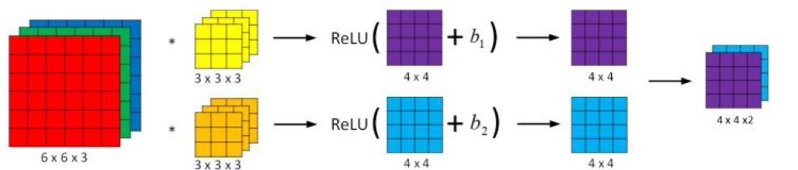
One Layer of a Convolutional Network
4x4 <= 6 – 3 + 1

Slide 34
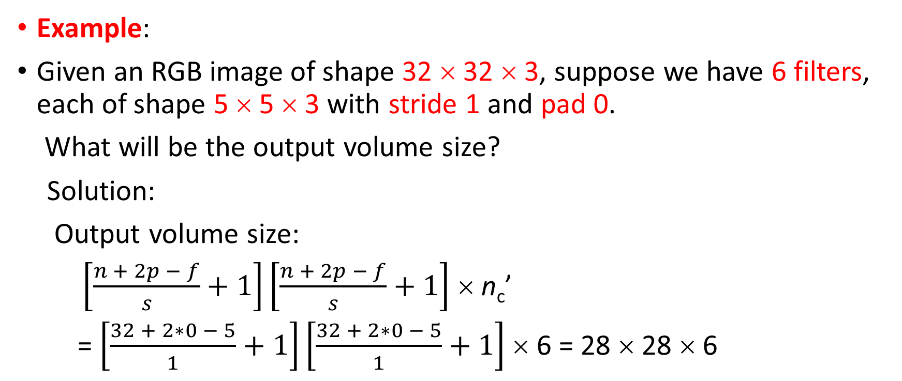
One Layer of a Convolutional Network
Example:
Given an RGB image of shape 32 × 32 × 3, suppose we have 6 filters, each of shape 5 × 5 × 3 with stride 1 and pad 0.
What will be the output volume size?
Solution:
Output volume size:
$\left[\frac{n + 2p − f}{s}+1\right]\left[\frac{n + 2p − f}{s}+1\right]$ × n_{c}’
= $\left[\frac{32 + 2∗0 − 5}{1}+1\right]\left[\frac{32 + 2∗0 − 5}{1}+1\right]$ × 6 = 28 × 28 × 6

Slide 35
One Layer of a Convolutional Network
Example:
Given an RGB image of shape 32 × 32 × 3, suppose we have 6 filters, each of shape 5 × 5 × 3 with stride 1 and pad 0.
What will be the number of parameters in the layer?
Solution:
Number of parameters for each filter (一個filter)= 5*5*3 = 75
There will be a bias term for each filter, so total parameters per filter = 76 (一個filter會有一個bias，所以+1)
As there are 6 filters, the total parameters for that layer = 76*6 = 456 (共有6個filters，所以會有76*6(個)

Slide 36
Why Convolutions?
Two main advantages(優點) of convolutions are:
Parameter sharing
To learn the same feature in different parts of the image, a single feature detector (filter) is convolved over the entire input and hence the parameters are shared.
Sparsity of connections
In each layer, each output value depends only on a small number of inputs.

Slide 37
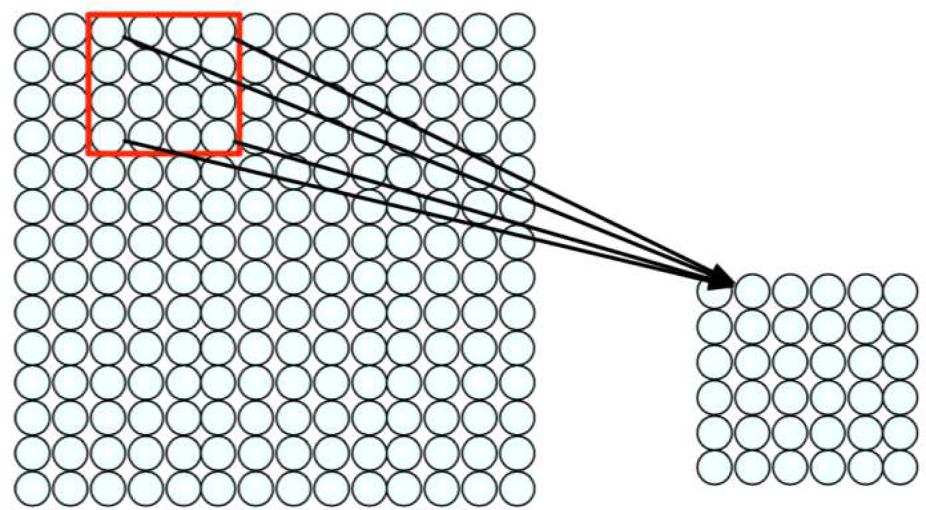
Why Convolutions?
Filter of size 4x4 : 16 different weights
Apply this same filter to 4x4 patches in input

Slide 38
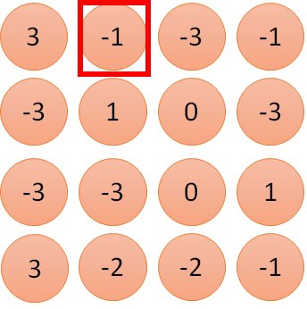
1:
1
Parameter sharing
2:
0
3:
0
3
1 | -1 | -1
-1 | 1 | -1
-1 | -1 | 1
4:
0
Filter 1
…
7:
0
8:
1
1 | 0 | 0 | 0 | 0 | 1
0 | 1 | 0 | 0 | 1 | 0
0 | 0 | 1 | 1 | 0 | 0
1 | 0 | 0 | 0 | 1 | 0
0 | 1 | 0 | 0 | 1 | 0
0 | 0 | 1 | 0 | 1 | 0
-1
9:
0
10:
0
…
13:
0
14:
0
15:
1
6 x 6 image
16:
1
Shared weights
…

Slide 39
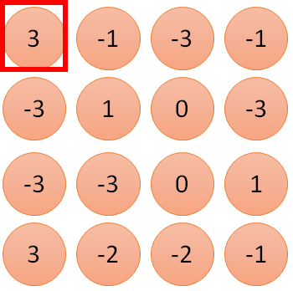
1
1
Sparsity of Connections
2
0
3
0
1 | -1 | -1
-1 | 1 | -1
-1 | -1 | 1
Filter 1
3
4
0
…
0
1 | 0 | 0 | 0 | 0 | 1
0 | 1 | 0 | 0 | 1 | 0
0 | 0 | 1 | 1 | 0 | 0
1 | 0 | 0 | 0 | 1 | 0
0 | 1 | 0 | 0 | 1 | 0
0 | 0 | 1 | 0 | 1 | 0
8
1
9
0
10
0
…
13
0
14
0
15
1
Only connect to 9 inputs, not fully connected
6 x 6 image
16
1
fewer parameters!
…

Slide 40
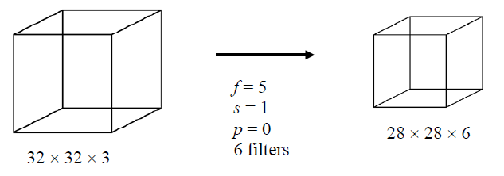
Sparsity of Connections
Example:
Fully connected layer:
Number of neurons in the input layer = 32*32*3 = 3072
Number of neurons in the output layer = 28*28*6 = 4704
Number of parameters = 4704 * 3072 + 4704 (biases) ≅ 14*10⁶
Convolution layer:
Number of parameters = (5*5*3 + 1) * 6 = 456
⇒ Convolutional layers reduce the number of parameters and speed up the training of the model significantly.

Slide 41
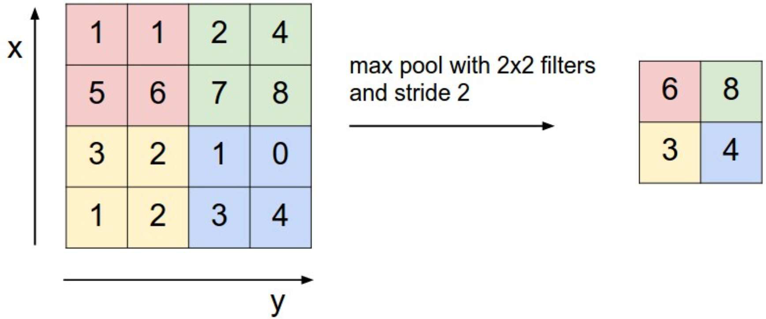
Goal：保留原來的資訊量，
降低運算的時間
Pooling Layer 池化層
Pooling layers are generally used to reduce the size of the inputs and hence speed up the computation(減少輸入的規模來加速運算的時間)
Reduced dimensionality (減少維度)
Spatial invariance (空間不變性)
概念有點像：照片不需要解析度那麼高，就可以分辨出那個是一棵樹

Slide 42
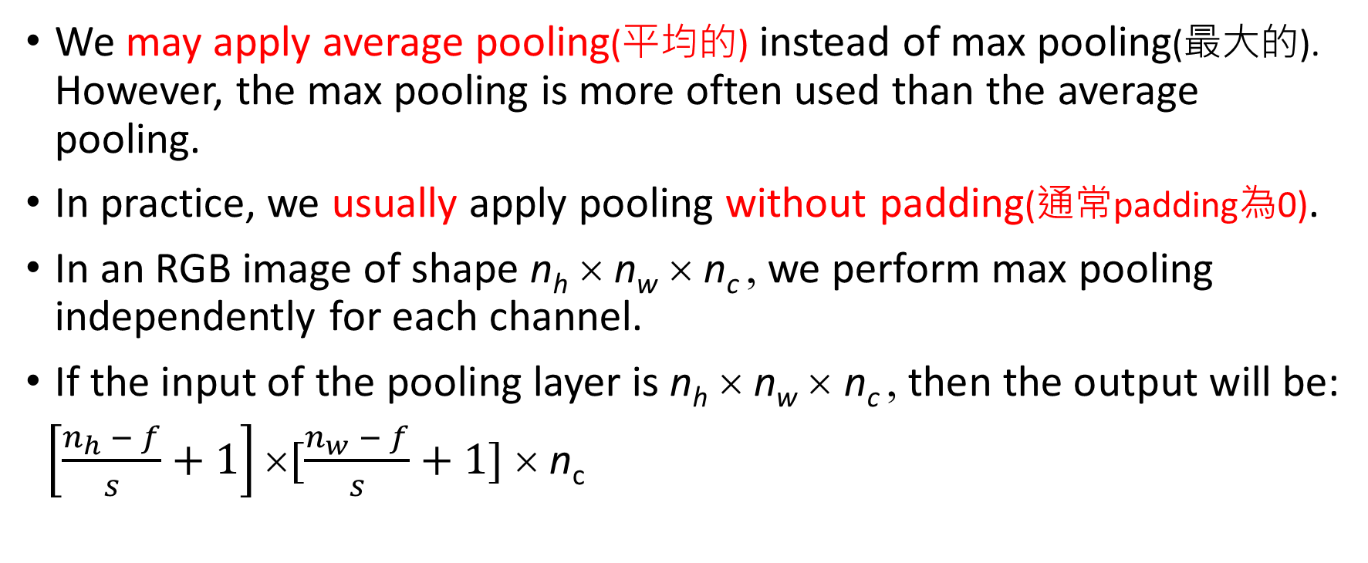
Pooling Layer
如果是辨識痣，如果是用平均pooling，資訊會被平均，痣的資訊會不明顯，所以用max pooling
We may apply average pooling(平均的) instead of max pooling(最大的). However, the max pooling is more often used than the average pooling.
In practice, we usually apply pooling without padding(通常padding為0).
In an RGB image of shape n_{h} × n_{w} × n_{c} , we perform max pooling independently for each channel.
If the input of the pooling layer is n_{h} × n_{w} × n_{c} , then the output will be:
$\left[\frac{n_{h} − f}{s}+1\right]×[\frac{n_{w} − f}{s}+1]$ × n_{c}
做完pooling，channel的數目必須保持一樣

Slide 43


Why Pooling?
Down sample and preserve spatial invariance
一個壓縮圖片並保留重要資訊的方法
bird
bird
We can subsample the pixels to make image smaller
Fewer parameters to characterize the image
Speed up the computation

Slide 44


The whole CNN
cat dog ……
Convolution
Max Pooling
Can repeat many times
Fully Connected Feed forward network
Convolution
Max Pooling
Flattened

Slide 45
The whole CNN
3
0
-1
1
Convolution
3
1
0
3
Max Pooling
Can repeat many times
A new image
Convolution
Smaller than the original image
Max Pooling

Slide 46
Flattening
3
0
1
3
0
-1
1
3
3
1
-1
0
3
Flattened
1
Fully Connected Feedforward network
0
3

Slide 47
The whole CNN
cat dog ……
Convolution
Max Pooling
Fully Connected Feedforward network
A new image
Convolution
Max Pooling
Flattened
A new image

Slide 48
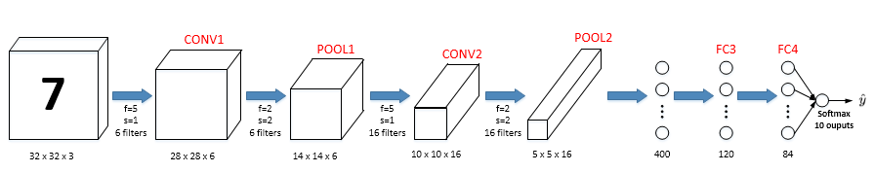
Convolutional Neural Network Example
超級參數(人自己選的，沒有原因的)
Layer 1
Layer 2

Slide 49
Convolutional Neural Network Example
 | Activation Shape | Activation Size | # Parameters
Input | (32, 32, 3) | 3,072 | 0
CONV1 (f =5, s = 1) | (28, 28, 6) | 4,704 | 456
POOL1 (f =2, s = 2) | (14, 14, 6) | 1,176 | 0
CONV2 (f =5, s = 1) | (10, 10, 16) | 1,600 | 2,416
POOL2 (f =2, s = 2) | (5, 5, 16) | 400 | 0
FC3 | (120, 1) | 120 | 48,120
FC4 | (84, 1) | 84 | 10,164
Softmax | (10, 1) | 10 | 850
( =120*400+120)

Slide 50
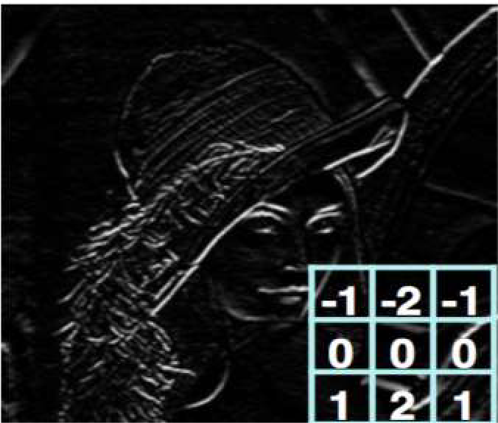
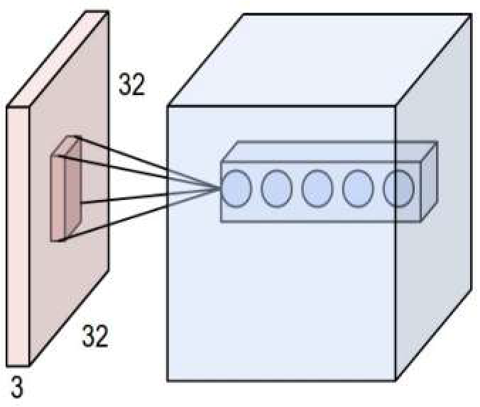
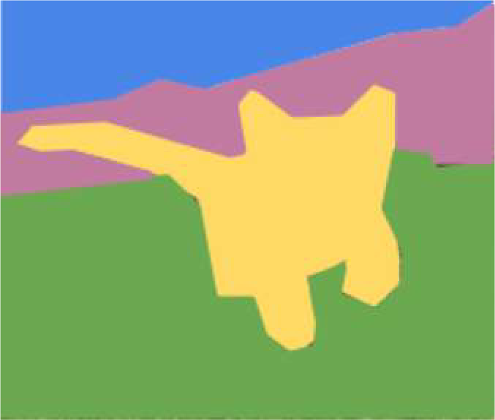
Deep Learning for Computer Vision: Summary
Foundations
Why computer vision?
Representing images
Convolutions for feature extraction
CNNs
CNN architecture
Application to classification
ImageNet
Applications
Segmentation, object detection, image captioning
Visualization
1/29/19

Slide 51
Resources
Stanford CS230: Deep Learning
Stanford CS231n: Convolutional Neural Networks for Visual Recognition
MIT 6.S191: Introduction to Deep Learning

